Slide 1
Kickstarter
Predicting campaign success on
Natasha Borders

Slide 2
How does Kickstarter work?
All or nothing funding model:
If the campaign fails, no money changes hands
Risk-free for the backer
Creators want the campaign to succeed
Kickstarter profits from managing both sets of expectations
The goal is to inform the creators how to
improve their chance of success on this platform

Slide 3
Data Analysis Pipeline
Data Cleaning and Feature Engineering
Grid Search CV on best models
Deploying best models with Flask
Model Selection and Evaluation
Finetuning the winning models

Slide 4

What kind of information can be used to predict campaign outcome?
Goal in USD
Campaign length in days
Category
Where the project is based
Marked as “Projects We Love”
Length of Description
Dataset obtained from a scraping website and compiled by aggregating monthly data covering April 2018-March 2019

Slide 5
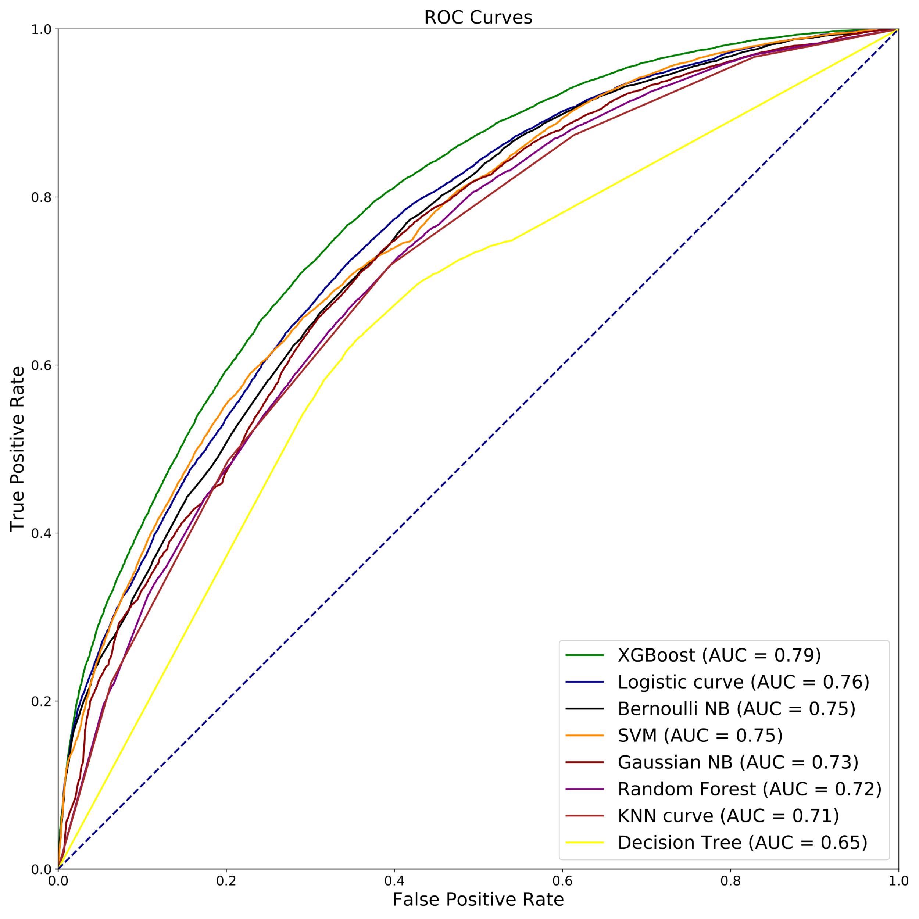
Model Evaluation
‘Success’ Class | Precision
XGBoost | .71
Logistic Regression | .69
Bernoulli NB | .68
SVM | .72
Gaussian NB | .64
Random Forest | .69
KNN | .68
Decision Tree | .67
XGBoost
(AUC = 0.79)

Slide 6
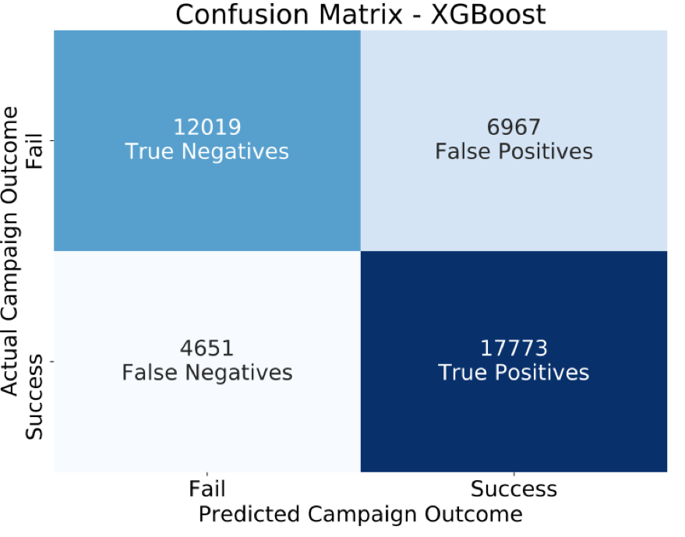
Top Model Performance on Test Data
 | XGBoost
AUC | .79
Precision ‘Success’ Class | .72

Slide 7
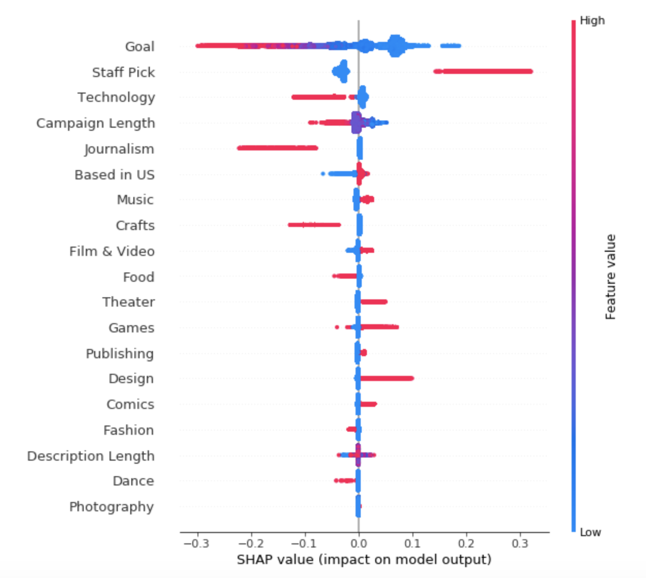
Feature Importance with XGBoost
Having a high goal is detrimental
Setting a low goal has a positive impact
Being featured as a Staff Pick has a high degree of positive impact
Campaign length hovers around 30 days
Design and Games are hotter categories
Journalism and Crafts are less so.
https://github.com/slundberg/shap
Notes:
In summary, Shapley values calculate the importance of a feature by comparing what a model predicts with and without the feature. However, since the order in which a model sees features can affect its predictions, this is done in every possible order, so that the features are fairly compared.
To get an overview of which features are most important for a model we can plot the SHAP values of every feature for every sample. The plot below sorts features by the sum of SHAP value magnitudes over all samples, and uses SHAP values to show the distribution of the impacts each feature has on the model output. The color represents the feature value (red high, blue low). This reveals for example that a high LSTAT (% lower status of the population) lowers the predicted home price.

Slide 8
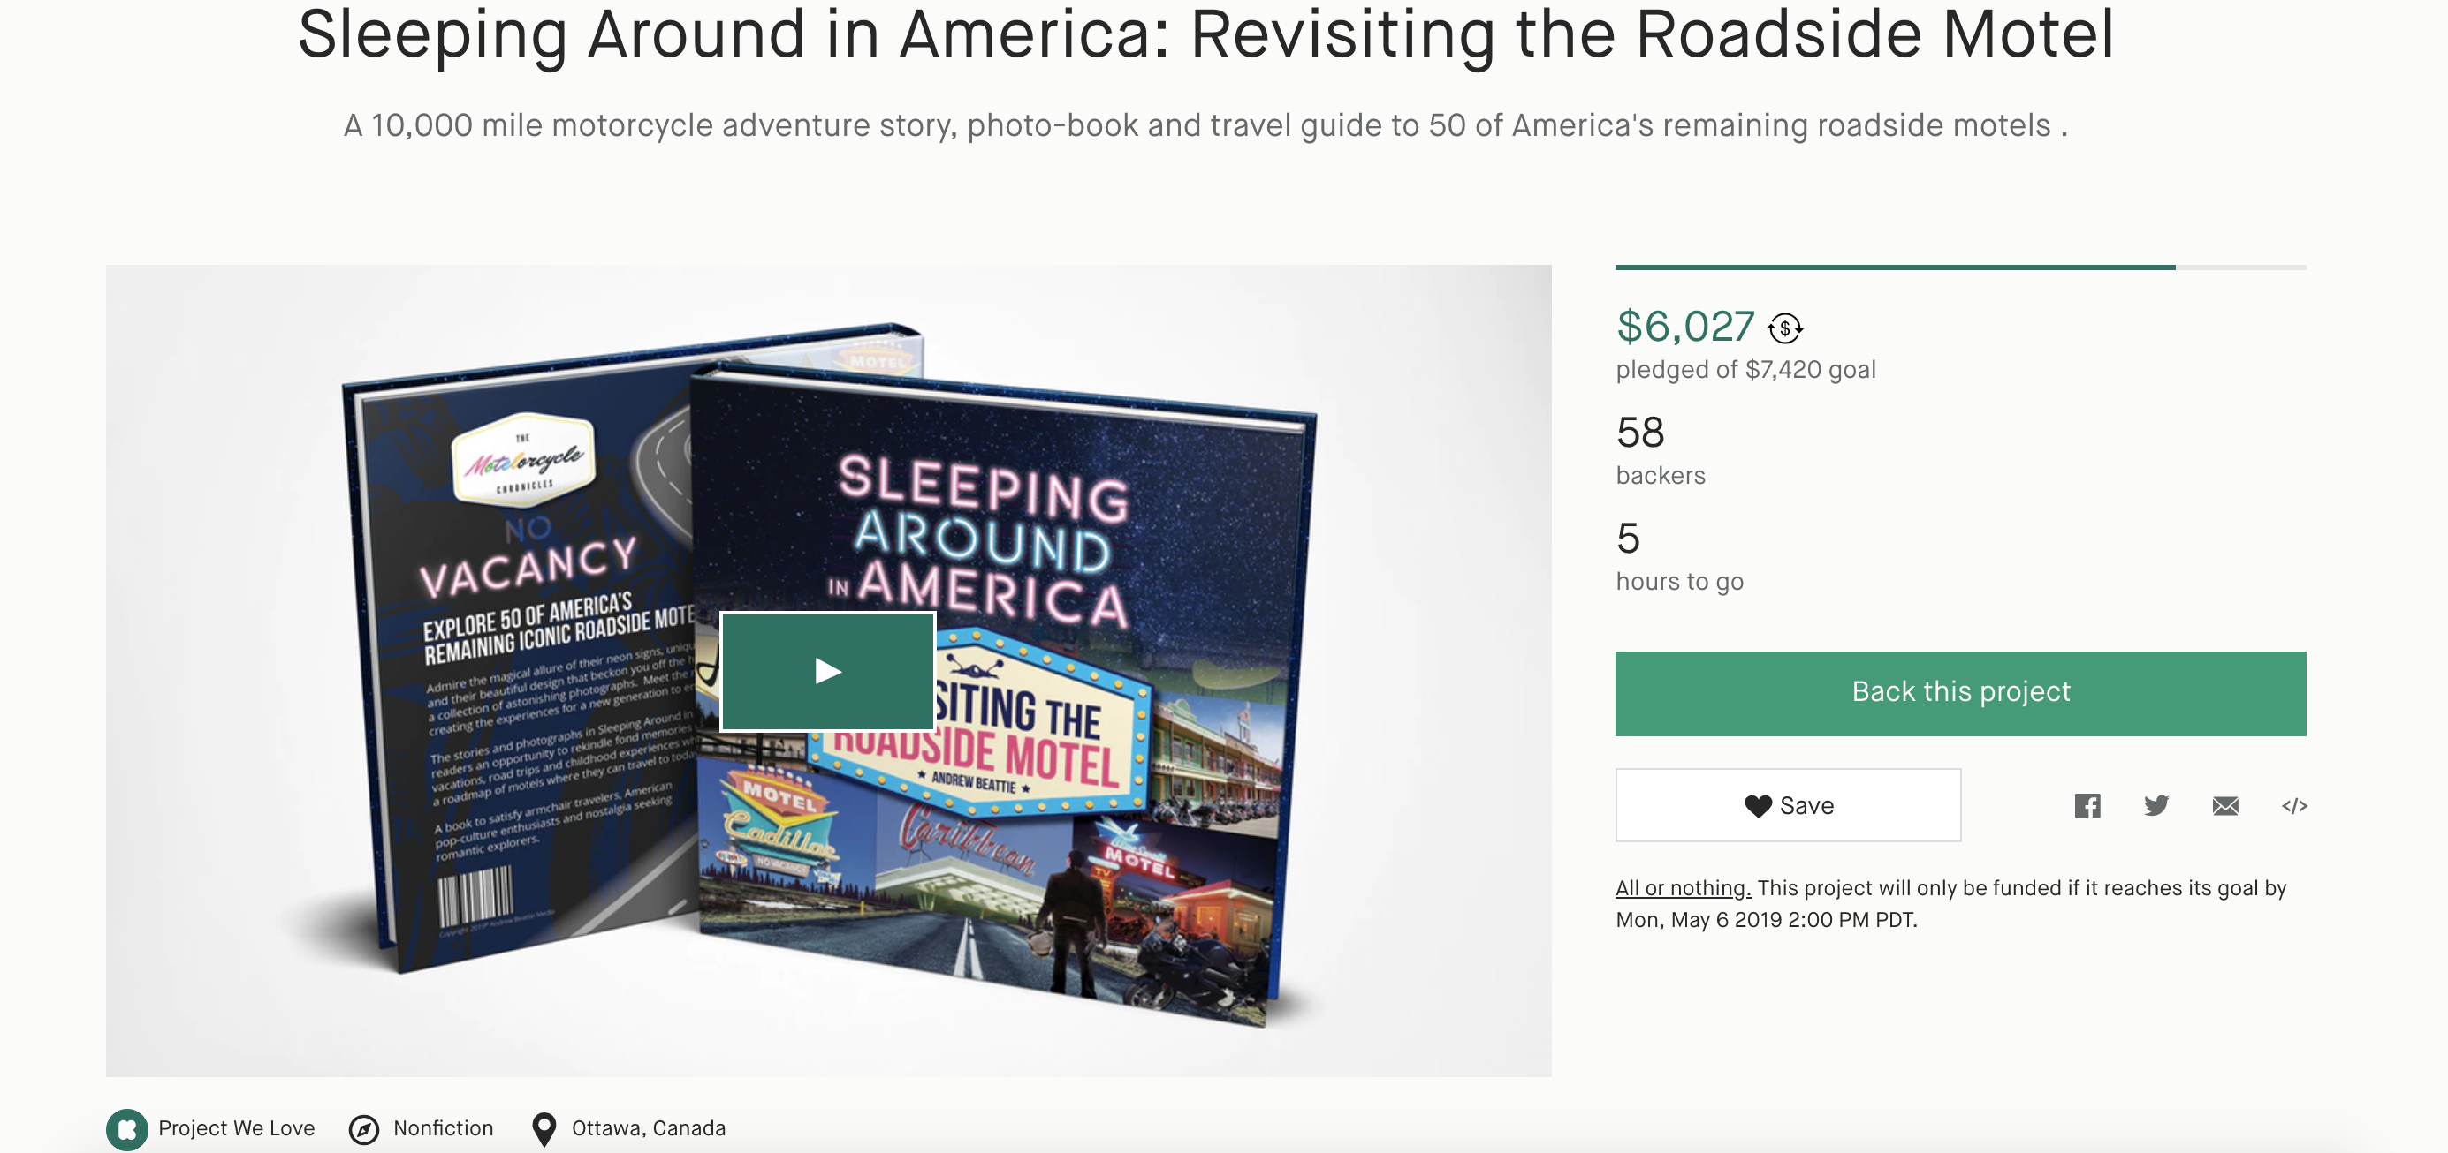
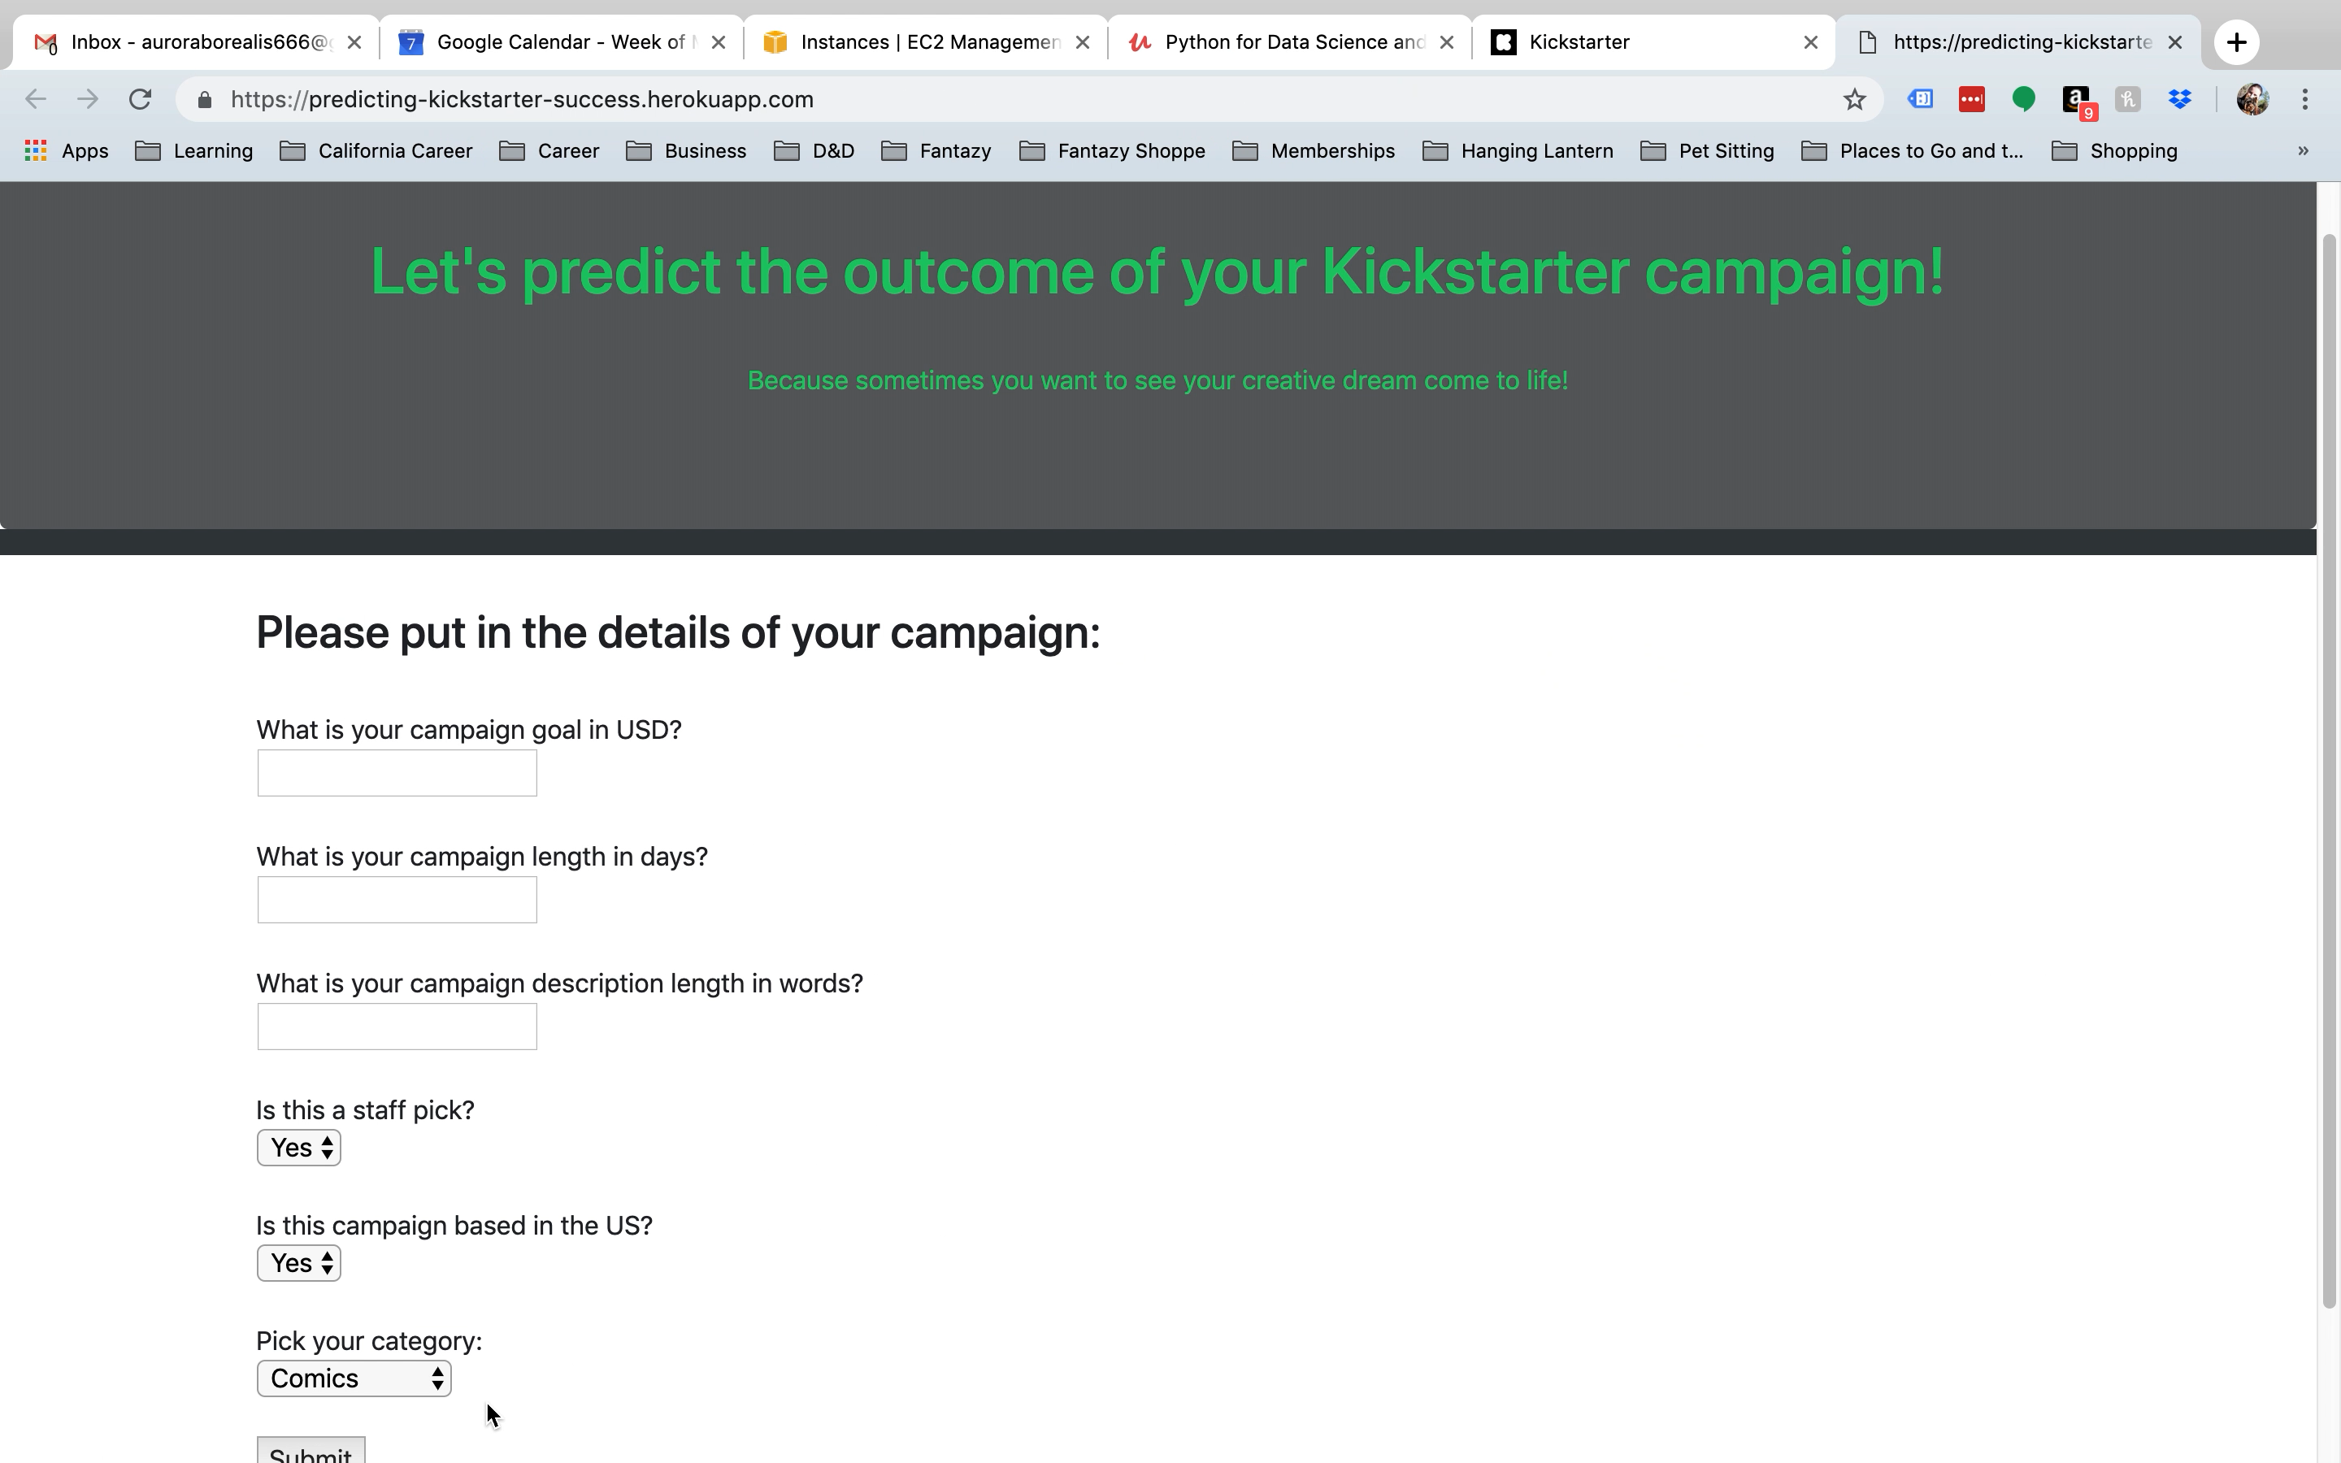
Deploying the Flask App

Slide 9
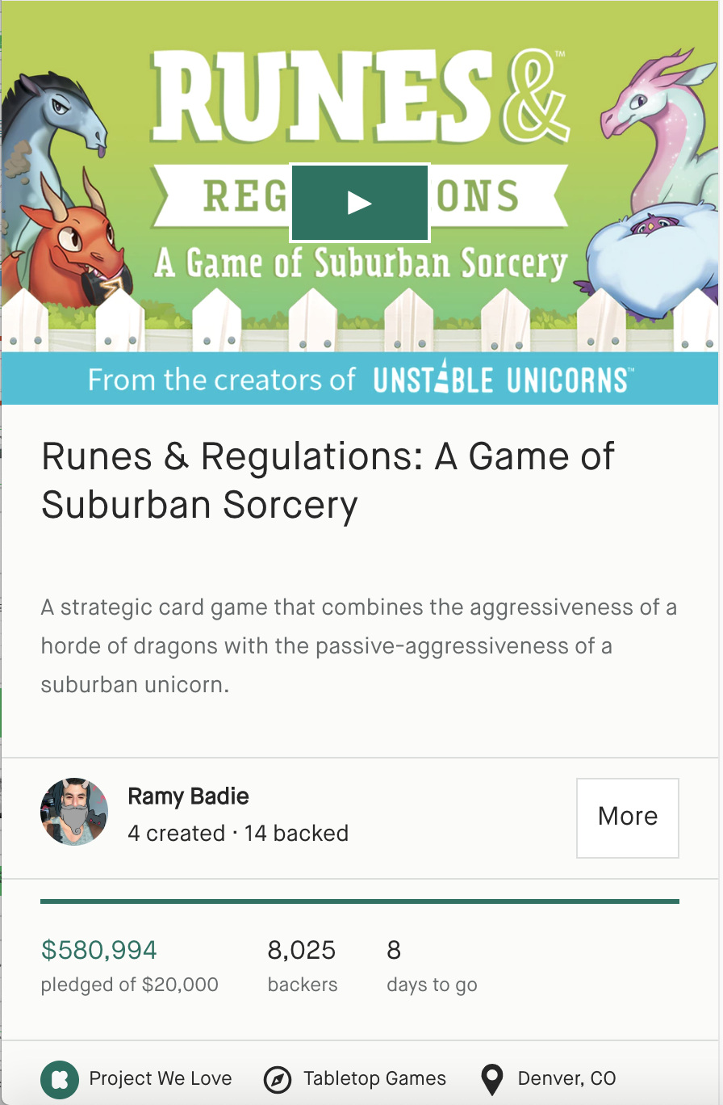
Recommendations
Set a small goal in USD that fits the scope of the campaign
Don’t stretch the campaign past 30 days
Consider the category carefully:
Games and Design are more popular
Journalism and Crafts less so

Slide 10
Next Steps
Develop XGBoost Heroku app
1
Explore trends within industries
2
What will the future bring?
3
Full functionality and beautiful appearance
Which campaigns are leading the way?
K
Explore how quickly campaigns are fulfilled

Slide 11
Thank you!
Any questions?

